Slide 1
Memory Analysis with volatility
Moshe Caplan
moshecaplan@isis.poly.edu
Summer 2013
*Presentation partially based on material created for the 2013 CSAW Cybersecurity Summer Bootcamp:
http://cyfor.isis.poly.edu/54-2013_hsf_teacher_summer_bootcamp_day_4.html

Slide 2
Memory Analysis: Definition
Memory Analysis is the science of using a memory image to determine information about running programs, the operating system, and the overall state of a computer.
-- Forensics Wiki
Definition obtained from: http://www.forensicswiki.org/wiki/Memory_analysis

Slide 3
Why is Memory Analysis Important?
Snapshot of machine state at capture time
Memory contains the data currently being used
Some data can only be obtained from memory
At the time of the memory capture:
What processes were running
What was the user doing
What files were open
Encrypted files in use are decrypted in memory

Slide 4
Things to Remember
For our purposes “Memory” is RAM
RAM is Volatile Memory
Memory that cannot retain data without power
Data is gone when system is shut off
It is then too late to capture memory for Forensic use
As opposed to Non-Volatile Memory
Memory that does retain data without power
Such as hard drives

Slide 5
Volatility
One of the premier memory analysis tools
FREE and Open Source
Written in Python
Runs on Windows, Linux, Mac
Command Line Tool (no GUI)
Runs a specified plugin against a memory image
Each plugin analyzes / extracts specific data from it
Process or file information
Data at specific memory addresses
Network Connections (etc.)
The next two slides provide a much more detailed definition and list of Volatility’s capabilities.

Slide 6
Volatility - Summary
The Volatility Framework is a completely open collection of tools, implemented in Python under the GNU General Public License, for the extraction of digital artifacts from volatile memory (RAM) samples. The extraction techniques are performed completely independent of the system being investigated but offer unprecedented visibility into the runtime state of the system. The framework is intended to introduce people to the techniques and complexities associated with extracting digital artifacts from volatile memory samples and provide a platform for further work into this exciting area of research.
Definition obtained from: https://www.volatilesystems.com/default/volatility

Slide 7
What Can Volatility Do?
Image information (date, time, CPU count)
Running processes
Process SIDs and environment variables
Open network sockets
Open network connections
DLLs loaded for each process
Open handles to all kernel/executive objects (files, keys, mutexes)
OS kernel modules
Dump any process, DLL, or module to disk
Mapping physical offsets to virtual addresses
Virtual Address Descriptor information
Addressable memory for each process
Memory maps for each process
Extract executable samples
Scanning examples: processes, threads, sockets, connections, modules
Command histories (cmd.exe) and console input/output buffers
Imported and exported API functions
PE version information
System call tables (IDT, GDT, SSDT)
API hooks in user- and kernel-mode (inline, IAT, EAT, NT syscall, winsock)
Explore cached registry hives
Dump LM/NTLM hashes and LSA secrets
User assist and shimcache exploration
Scan for byte patterns, regular expressions, or strings in memory
Analyze kernel timers and callback functions
Report on windows services
Data obtained from: https://www.volatilesystems.com/default/volatility

Slide 8
Obtaining Volatility
Preinstalled on Kali
CERT ADIA and SANS SIFT as well
Otherwise:
Company Website
https://www.volatilesystems.com/default/volatility
However, most Volatility stuff can be found here:
https://code.google.com/p/volatility/
Downloads
Great Documentation
Sample Memory Images
Cheat Sheets
Links to blogs, articles, etc. discussing Volatility

Slide 9
Running Volatility
Name of Command: “vol”
May need to specify “python vol.py” instead
This tells python to run the file “vol.py”
Basic Format:
<command> <options> <plugin to run>
Example: vol –f image.vmem imageinfo
Run the imageinfo plugin against the image.vmem file
-f option specifies the file (memory) you are analyzing
“vol –h” will list all available options and plugins

Slide 10
Demo: Volatility
Let’s run Volatility against known malware ☺
Zeus exploit kit (zeus.vmem)
Sample Memory Image Provided by Volatility
https://code.google.com/p/volatility/wiki/SampleMemoryImages
Goal:
A brief intro to Volatility’s extensive capabilities
We will only do the first few steps of this analysis
Just enough to highly suspect malicious activity
The remaining steps are left for the challenge

Slide 11
Analysis Steps - Plugins
First lets see what sort of image this is
Plugin: imageinfo
Let’s check for any suspicious processes that were running at capture time
Plugin: pslist
Were there any open network connections?
Plugin: connections
What about recently terminated connections?
Plugin: connscan
BINGO

Slide 12
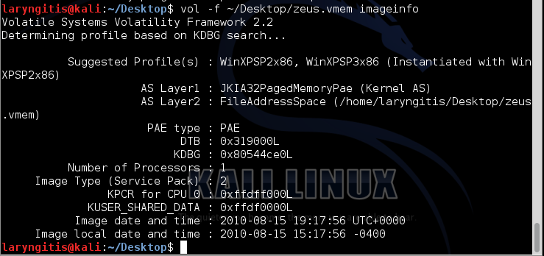
imageinfo
The image is from a Windows XP machine
Helpful to know the OS we are analyzing

Slide 13
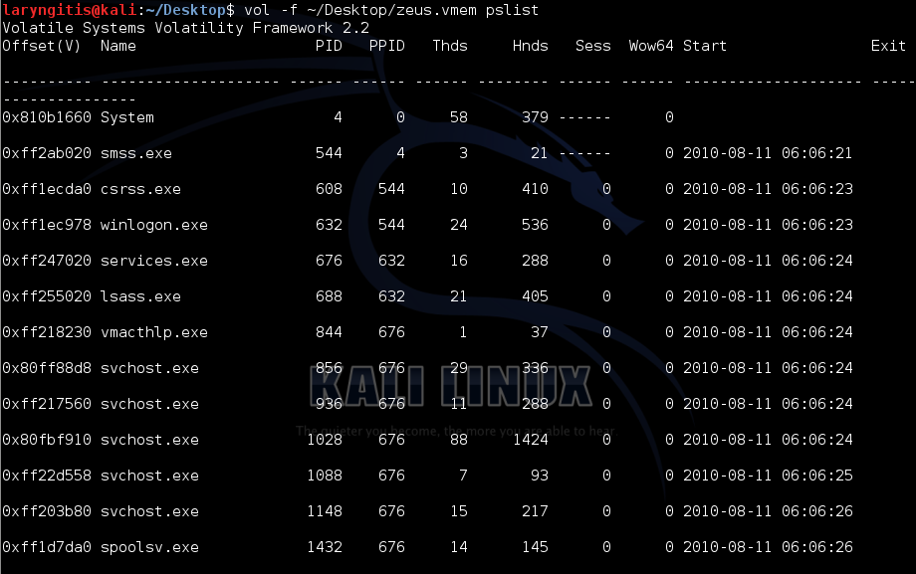
pslist
Nothing immediately stands out as suspicious
For example, no process names with random strings of alphanumeric characters

Slide 14

connections
No open connections at the time of capture
The machine was not actively communicating with anyone
Would have been too easy ☺

Slide 15
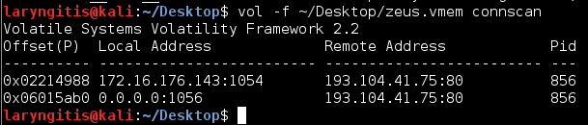
connscan
Previously closed connections
Shows that at some recent point our machine (local) talked to a machine (remote) at the 193 IP
DON’T GO TO THAT IP. IT IS LIKELY MALICIOUS
I wonder where that IP is located?

Slide 16
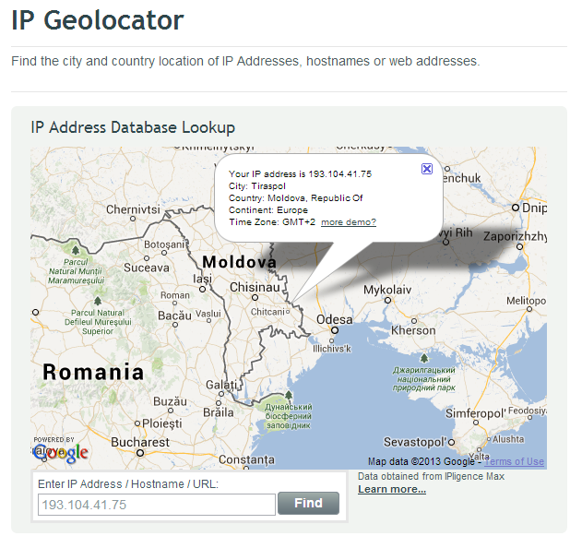
IP Lookup
Many tools will identify an IP’s location
Screenshot is from “IPLigence” geolocation
http://www.ipligence.com/geolocation
Why was I talking to a machine in Moldova?
Highly Suspicious
Warrants further investigation

Slide 17
Taking This Demo Further
I highly recommend the following walkthrough
http://malwarereversing.wordpress.com/2011/09/23/zeus-analysis-in-volatility-2-0/
It performs a much more complete analysis of this image
Much of my demo came from there
That is the challenge for this module
You can also find similar extensive walkthroughs on the Volatility links page:
https://code.google.com/p/volatility/wiki/VolatilityDocumentationProject

